Slide 1
S.W.A.G
EDUCATIONAL TRAVELLING

Slide 2
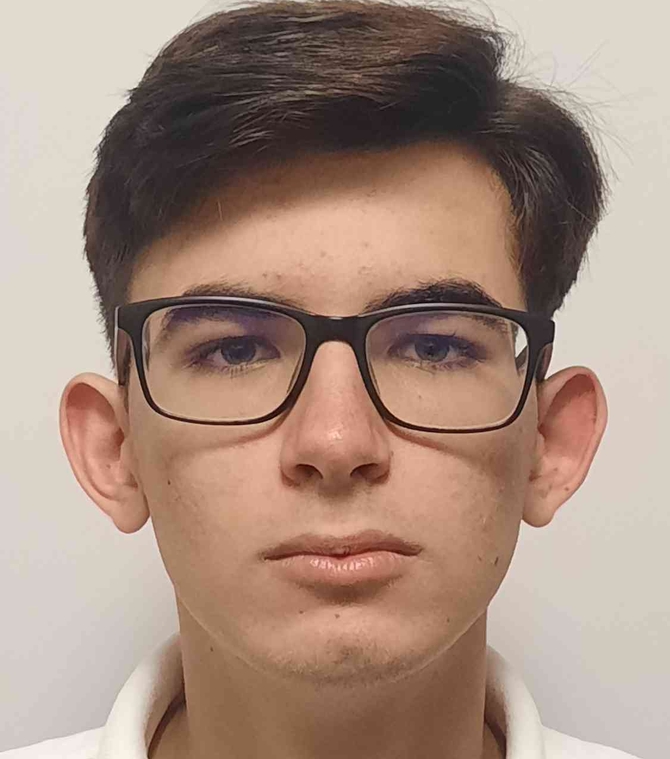
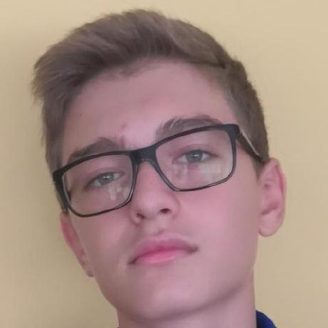
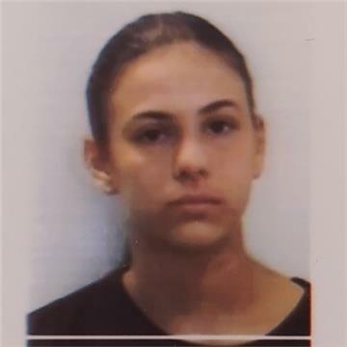
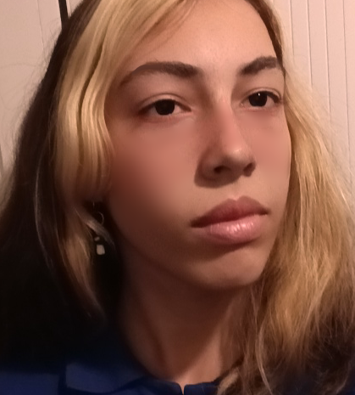
OUR TEAM
Konstantin Dinev
Scrum Trainer
Kaloqn Dimov
Back-end
Victoria Bolashikova
Back-end
Gergana Bineva
QA Engineer

Slide 3
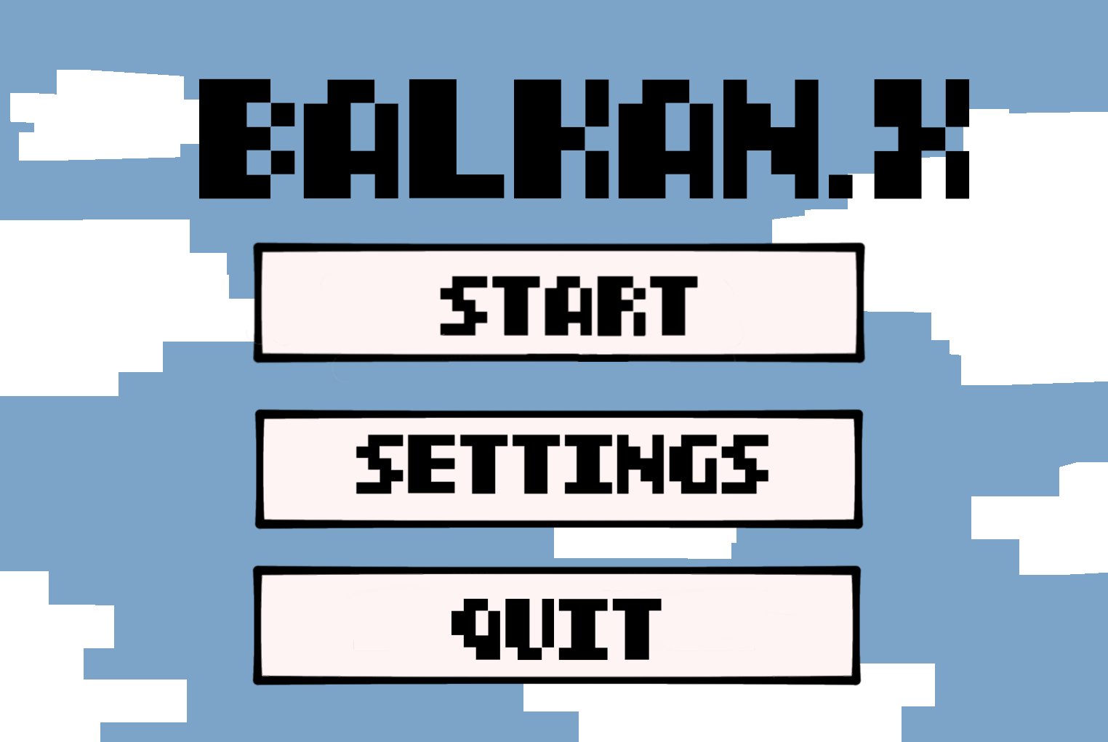
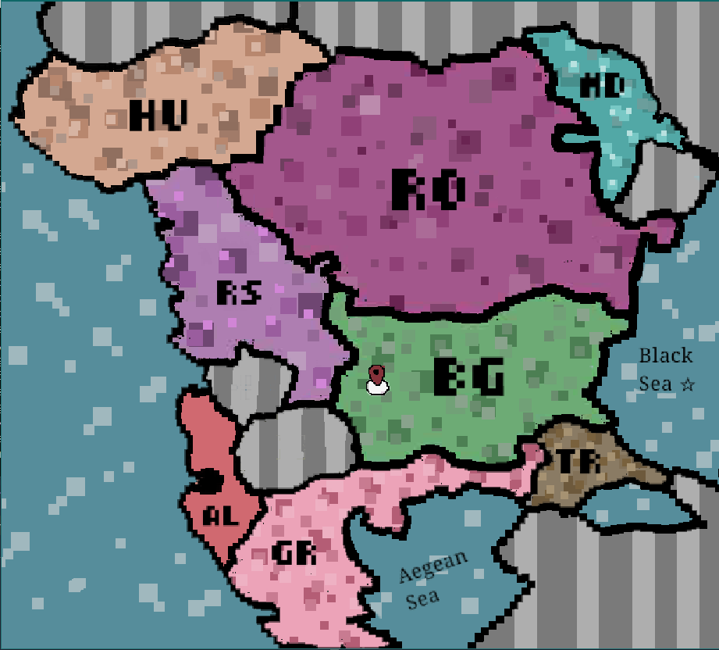
OUR IDEA

Slide 4
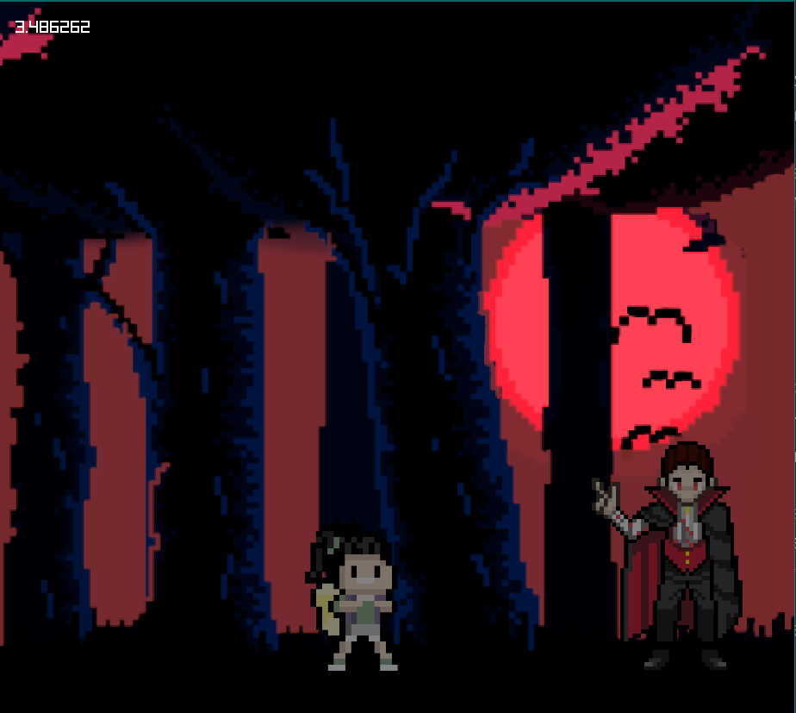
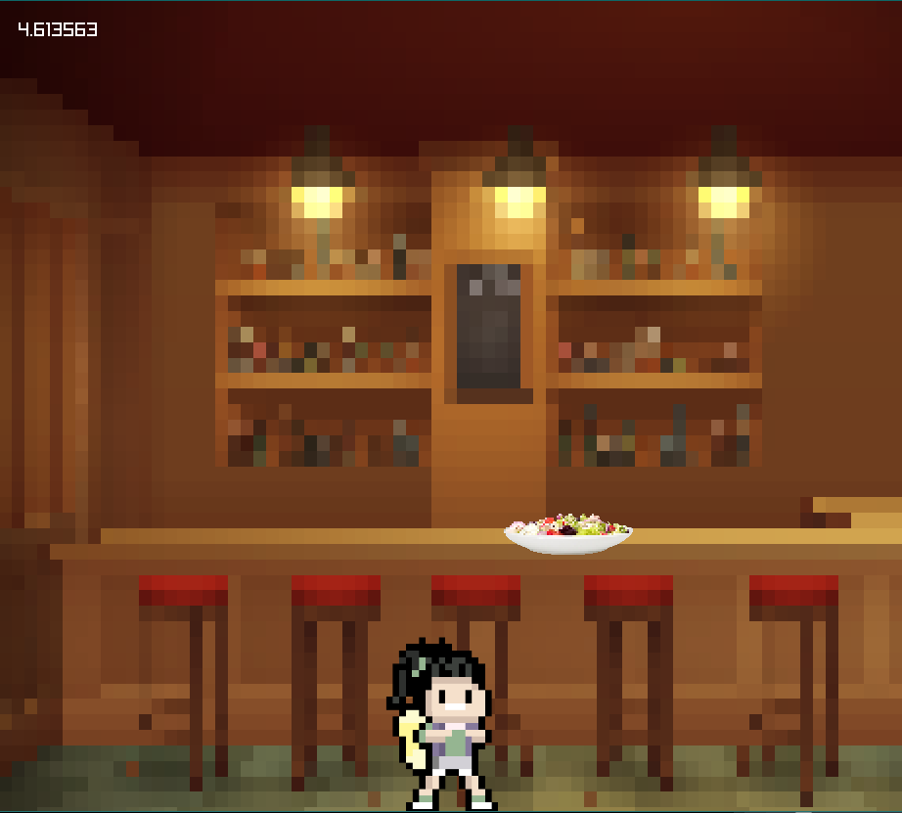
OUR IDEA

Slide 5
STAGES OF DEVELOPMENT

Slide 6










USED PROGRAMS

Slide 7
LET’S JUMP TO THE PROJECT!

Slide 8
THANK YOU FOR YOUR ATTENTION!

